Slide 1
Direct Line
Jenna Dorsey, Nishta Patel, and Marie Gilbert

Slide 2
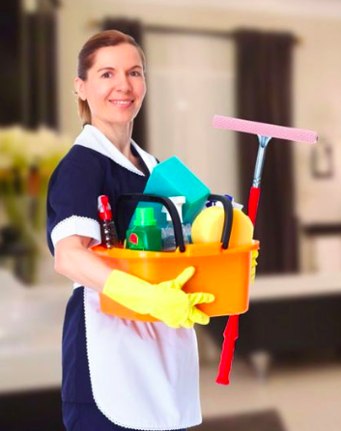
Janet,
Head Housekeeper
Janet has been working in the hotel industry for 15 years and has been head of the housekeeping staff for 7. She oversees all operations of housekeeping and maintenance in the building. She struggles to communicate quickly and efficiently with hotel management and those that she supervises, especially due to language barriers.
Direct line would improve Janet’s efficiency at work because she could instantly share important messages with any member of the hotel staff.

Slide 3
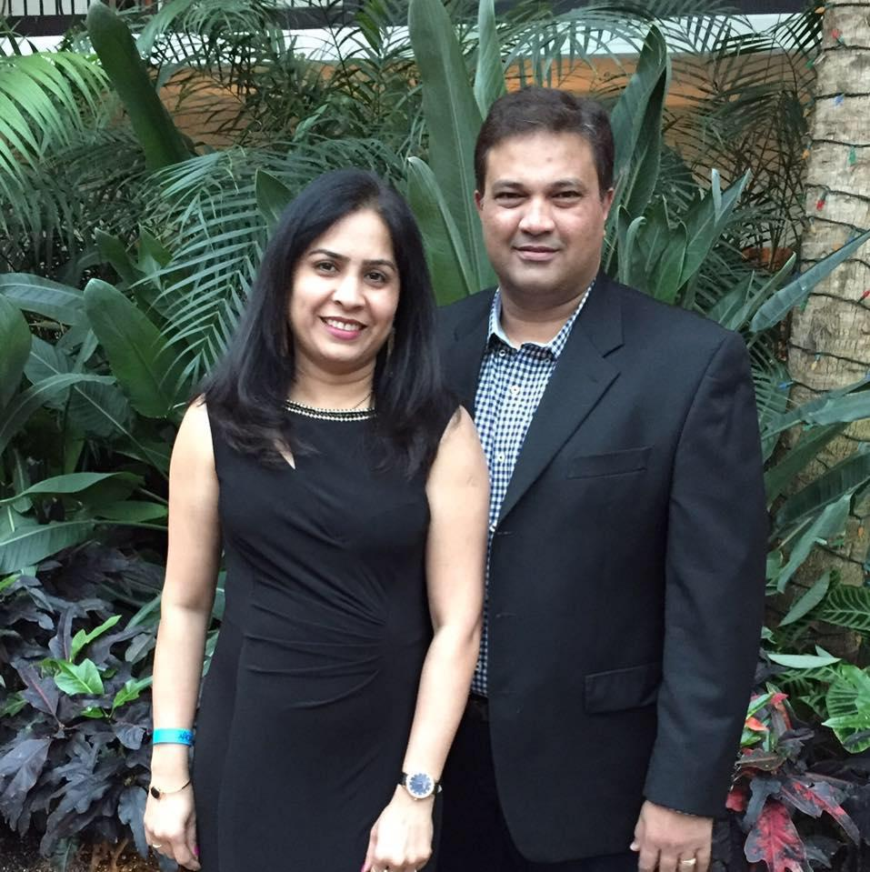
Anil and Dharmi, Hotel Owners
Anil has been a hotel owner for the past 18 years. He oversees two properties nearly 120 miles apart. While he has a system in place currently for communication between the staff, he is looking to transition to a more efficient method. Anil is concerned with the hotels customers not being pleased with their stay and overall ratings/reviews.
Dharmi has worked alongside Anil for the past 18 years. While she doesn’t oversee the entire property, she oversees the back staff of the hotel and takes on the role of head housekeeper. Like Anil, she is concerned that tasks assigned to back staff are not being completed in a timely manner or with quality.
DirectLine will help improve the line of connection between management and staff and help Anil oversee his properties from miles away

Slide 4
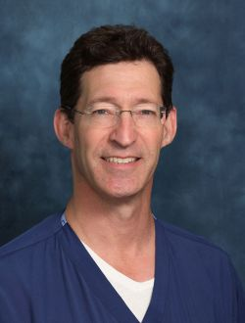
Dr. Tom Pereles
Dr. Pereles has been working at Sentara RMH for the last 5 years. He has been an emergency room physician for the past 3. He is comfortable with technology as he has to use multiple electronic medical record systems and keep up with his pages on his cell phone. However with all the technology in a hospital he still feels that the overhead paging system is outdated and sometimes scares patients.
Direct line would get rid of the antiquated paging system which would help Dr. Pereles know important information more discretely and ease his patients minds.

Slide 5
In industry not everyone has a smartphone...
Since not all employees have access to smartphones it would be most efficient for each establishment to have a set of devices that stay on the campus and are just checked out and used by employees when they are on shift. This way people do not forget to turn their app on at work or off when they go home. Also the employer would just have to buy the device not a phone plan because the app could just connect to the existing wifi.

